Slide 1
Garbage Classification Using Deep Learning
“An AI-Powered System to Identify and Classify Household Waste Materials”

Slide 2
Project Description
This project is being created to identify and classify garbage into different categories through Deep Learning. It mainly uses Convolutional Neural Network (CNN) which takes the image as input and works on it with Deep Learning techniques to identify the type of garbage - like Plastic, Glass, Metal, Paper or Organic Waste.
In today's time, due to increasing garbage, manual sorting takes a lot of time and effort. To reduce this problem, this Deep Learning Model will be very useful for Waste Management Companies and Municipalities. The model will automatically put the garbage in the right category, which will make the recycling process easier and also reduce environmental pollution.

Slide 3
Python programming language is being used in this project and libraries such as TensorFlow, Keras, OpenCV are being used for image processing, feature extraction and model training. Different types of garbage images have been taken in the dataset which have been split for train and test so that the model can be taught to classify with accuracy.
In future, this model can be integrated into mobile app or web application so that people can separate garbage properly from their home or office. Overall, this project is a good example of practical implementation of deep learning and it will help the society to move forward towards smart waste management system.

Slide 4
Objective of the project
To develop an automatic waste classification system using Deep Learning and Convolutional Neural Networks (CNN).
To train a CNN model that can detect and classify garbage images into categories like plastic, metal, glass, paper, and organic waste.
To reduce manual effort in waste segregation and improve recycling processes with accurate predictions.
To apply modern Deep Learning techniques for real-time and large-scale garbage sorting.
To deploy the trained model in future as a mobile or web-based smart waste management solution.

Slide 5
Challenges & Scope
Challenges
One of the main challenges in this garbage classification project is collecting a large and diverse dataset of garbage images covering all possible categories like plastic, metal, glass, paper, and organic waste. It can be difficult to get high-quality labeled images for each type of waste. Another challenge is to maintain high accuracy while classifying different waste types because the appearance of garbage can vary due to lighting, background, and mixed waste conditions. Also, training a deep learning model like CNN requires good hardware resources and enough training time to get better performance.

Slide 6
Scope
The scope of this project is to build an efficient AI-based solution that helps in automatic waste detection and sorting, which will reduce manual labor and save time. This model can be further improved by adding more waste categories or using advanced deep learning architectures for better accuracy. In the future, the trained model can be integrated into mobile or web applications, smart bins, or industrial waste management systems to make the recycling process faster and more eco-friendly.

Slide 7
Expected Benefits:
This project will help automate the waste classification process, which will make waste management more efficient and organized. By using a deep learning model to detect and sort garbage, the need for manual waste segregation will be reduced, saving time and effort. It will also help in better recycling and reuse of waste materials, which will reduce the load on dumping grounds and protect the environm- -ent.Overall, this system will contribute to cleaner surroundings and promote eco-friendly practices in waste disposal.

Slide 8
How the Model Works
The garbage classification model is based on a Convolutional Neural Network (CNN). First, the system takes an image of the waste item as input. Then, the CNN extracts important features from the image such as shapes, edges, and textures. These features are passed through multiple hidden layers of the network. The final output layer predicts the category of the waste item (for example, plastic, glass, metal, paper, or organic). This way, the model automatically classifies the input garbage image into the correct category with good accuracy.

Slide 9
Required Libraries & Tools:
To build and train the garbage classification model, we are using Python programming language along with some important libraries and tools. The main libraries are:
TensorFlow and Keras: for building and training the CNN model.
OpenCV: for image processing tasks like resizing, augmentation, etc.
NumPy: for numerical operations and array handling.
Matplotlib/Seaborn: for visualizing data, training accuracy, and loss graphs.
Additionally, we need a GPU-enabled environment (if possible) to train the deep learning model faster.

Slide 10
DataSet Details
For this project, a total of approximately 2527 garbage images were collected from various online sources and open datasets.
The dataset covers different waste categories such as cardbords Plastic, Glass, Metal, Paper, and trash ,Organic Waste.
All images were resized to a standard dimension of 128x128 pixels to ensure uniformity during training.
The dataset was split into 80% images for training the CNN model and 20% for testing and validation to check model performance.
Proper labeling was done for each image to train the model to classify the waste type accurately.

Slide 11
The "Garbage Image Dataset" reveals a noticeable imbalance in the distribution of its image categories:
Category | Image count | Update distribution
Cardboard | 403 | 15.09
Glass | 501 | 19.96
Metal | 410 | 16.68
Paper | 594 | 23.82
Plastic |  | 18.53
 | 482
Trash | 137 | 5.91

Slide 12
Data preprocessing
In this project, proper data preprocessing steps were performed to make the garbage images suitable for training the CNN model. First, all images were resized to a fixed dimension to ensure that the input size remains consistent during model training. This helps the model learn features properly. Next, the pixel values of each image were normalized by scaling them between 0 and 1. This normalization improves the performance and stability of the deep learning model. To increase the variety of training data and make the model more robust, data augmentation techniques were used. These include rotating images at different angles, flipping them horizontally or vertically, and applying random zooms. This helps the model handle real-life variations in waste images. For image processing tasks like resizing and reading images, the OpenCV library was used, while TensorFlow and Keras were used to handle image pipelines, perform augmentation, and feed the data into the CNN during training.

Slide 13
Resize and rescale images.
Apply data augmentation (e.g., RandomFlip, RandomRotation, RandomZoom) to improve generalization.
Normalize images (using preprocess_input if using pre-trained models like EfficientNet).
# Define data augmentation pipeline
data_augmentation = Sequential([
layers.RandomFlip("horizontal"),
layers.RandomRotation(0.1),
layers.RandomZoom(0.1),
layers.RandomContrast(0.1),
])

Slide 14
Model architecture
In this project, a Convolutional Neural Network (CNN) architecture was designed for garbage classification. The model starts with an input layer that takes an RGB image of size 128x128x3. The first convolutional layer uses 32 filters with a 3x3 kernel size and ReLU activation function to extract basic features like edges and shapes. A MaxPooling2D layer is added next to reduce the spatial dimensions and control overfitting. After that, a second convolutional layer with 64 filters is used to learn more complex features. The output from the convolutional layers is flattened and passed through dense (fully connected) layers to make the final prediction. The output layer uses Softmax activation to classify the image into multiple waste categories. The Adam optimizer is used for training the model efficiently, and the categorical crossentropy loss function is used because it is suitable for multi-class classification problems.

Slide 15
Model Selection
Choose a base model: Custom CNN or Transfer Learning (e.g., EfficientNetV2B2).
Decide whether to use pre-trained weights (e.g., ImageNet).
Define whether layers should be trainable or frozen during initial training.
Model Training
Build the model architecture using Sequential or Functional API.
Compile the model with loss function ( sparse_categorical_crossentropy), optimizer (e.g., Adam), and evaluation metrics (accuracy).
Model Tuning and Optimization
Tune hyperparameters: learning rate, batch size, number of layers, dropout rate.
Use callbacks: EarlyStopping,
Optionally perform fine-tuning on pre-trained models by unfreezing some layers.

Slide 16
Model Performance Visualization: Accuracy & Loss Trends

Slide 17
Model performance Visualization: Accuracy & Loss Trends
acc = history.history['accuracy'] # Extract training accuracy from history
val_acc = history.history['val_accuracy'] # Extract validation accuracy from history
loss = history.history['loss'] # Extract training loss from history
val_loss = history.history['val_loss'] # Extract validation loss from history
epochs_range = range(len(acc)) # Define range for epochs based on accuracy length
plt.figure(figsize=(10,8)) # Set overall figure size for visualization
plt.subplot(1,2,1) # Create first subplot (1 row, 2 columns, position 1)
plt.plot(epochs_range, acc, label='Training Accuracy') # Plot training accuracy
plt.plot(epochs_range, val_acc, label='Validation Accuracy') # Plot validation accuracy
plt.legend(loc='lower right') # Place legend in lower-right corner
plt.title('Training vs Validation Accuracy') # Add title for accuracy plot
plt.subplot(1,2,2) # Create second subplot (1 row, 2 columns, position 2)
plt.plot(epochs_range, loss, label='Training Loss') # Plot training loss
plt.plot(epochs_range, val_loss, label='Validation Loss') # Plot validation loss
plt.legend(loc='upper right') # Place legend in upper-right corner
plt.title('Training vs Validation Loss') # Add title for loss plot
plt.show()

Slide 18
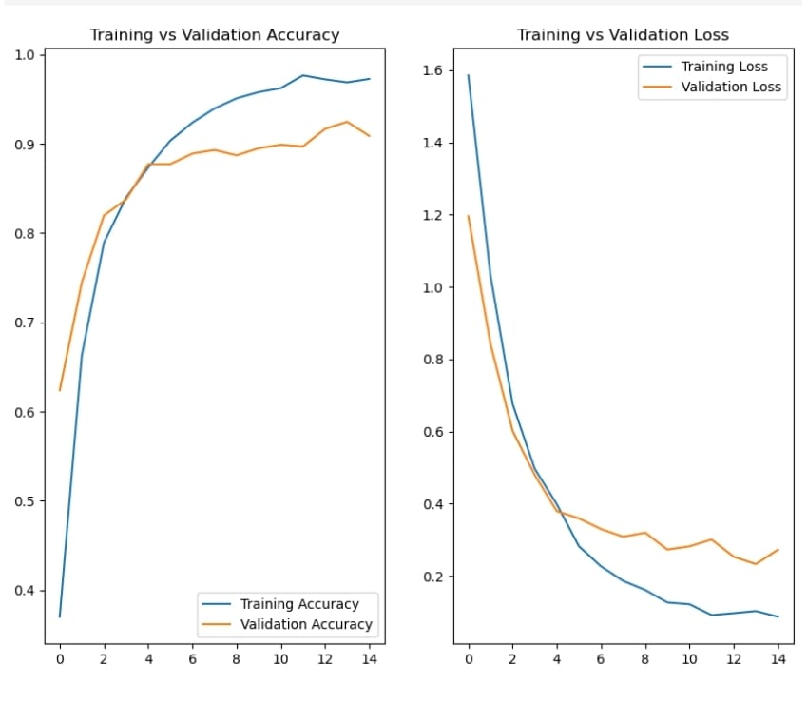

Slide 19
Model Evaluation
Plot training and validation accuracy/loss curves.
Evaluate model performance on validation or test set.
Use metrics like:
Confusion Matrix
Classification Report (Precision, Recall, F1-score)
confusion_matrix, classification_report: To evaluate the model's classification performance.

Slide 20
loss, accuracy = model.evaluate(test_ds_eval)
print(f'Test accuracy is{accuracy:.4f}, Test loss is {loss:.4f}')
8/8 ━━━━━━━━━━━━━━━━━━━━ 6s 744ms/step - accuracy: 0.9269 - loss: 0.2244
Test accuracy is0.9102, Test loss is 0.2628
# Extract true labels from all batches in the test dataset
y_true = np.concatenate([y.numpy() for x, y in test_ds_eval], axis=0) # Convert Tensor labels to NumPy array and concatenate them
# Get predictions as probabilities from the model
y_pred_probs = model.predict(test_ds_eval) # Predict class probabilities for each sample in the test dataset
# Convert probabilities to predicted class indices
y_pred = np.argmax(y_pred_probs, axis=1) # Select the class with the highest probability for each sample
# Compute the confusion matrix to evaluate classification performance
cm = confusion_matrix(y_true, y_pred) # Generate confusion matrix comparing true labels to predicted labels

Slide 21
# Print metrics to assess model performance
print(cm) # Display confusion matrix
print(classification_report(y_true, y_pred)) # Print precision, recall, and F1-score for each class
8/8 ━━━━━━━━━━━━━━━━━━━━ 20s 794ms/step
[[30 0 0 2 0 0]
[ 0 49 7 0 4 0]
[ 0 1 39 0 0 0]
[ 2 0 1 58 0 0]
[ 0 2 1 0 42 2]
[ 0 0 1 0 0 15]]
precision recall f1-score support
0 0.94 0.94 0.94 32
1 0.94 0.82 0.88 60
2 0.80 0.97 0.88 40
3 0.97 0.95 0.96 61
4 0.91 0.89 0.90 47
5 0.88 0.94 0.91 16
accuracy 0.91 256
macro avg 0.91 0.92 0.91 256
weighted avg 0.92 0.91 0.91 256

Slide 22
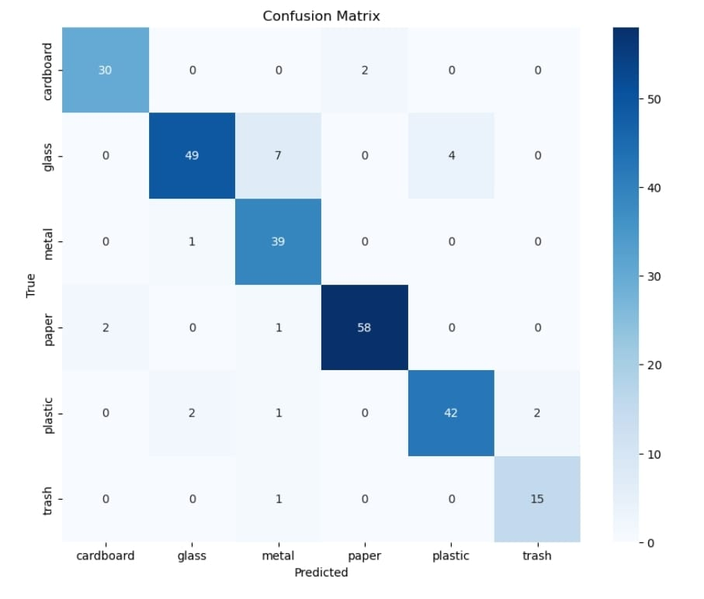

Slide 23
Code section

Slide 24
# Import necessary libraries
import tensorflow as tf
from tensorflow.keras.applications import MobileNetV2
from tensorflow.keras.models import Model
from tensorflow.keras.layers import Dense, GlobalAveragePooling2D, Dropout
from tensorflow.keras.preprocessing.image import ImageDataGenerator
# Step 1: Load the Pretrained MobileNetV2 Model
base_model = MobileNetV2(input_shape=(224, 224, 3), include_top=False, weights='imagenet')
# Step 2: Freeze the base model layers
for layer in base_model.layers:
layer.trainable = False
# Step 3: Add custom layers on top
x = base_model.output
x = GlobalAveragePooling2D()(x)
x = Dropout(0.3)(x)
x = Dense(128, activation='relu')(x)
x = Dropout(0.3)(x)
predictions = Dense(6, activation='softmax')(x)

Slide 25
# Step 4: Create final model
model = Model(inputs=base_model.input, outputs=predictions)
# Step 5: Compile the model
model.compile(optimizer='adam',
loss='categorical_crossentropy',
metrics=['accuracy'])
# Step 6: Data Preprocessing and Augmentation
train_datagen = ImageDataGenerator(rescale=1./255,
shear_range=0.2,
zoom_range=0.2,
horizontal_flip=True,
validation_split=0.2)
train_generator = train_datagen.flow_from_directory(
'/content/drive/MyDrive/Garbage_Dataset',
target_size=(224, 224),
batch_size=32,
class_mode='categorical',
subset='training'
)

Slide 26
val_generator = train_datagen.flow_from_directory(
'/content/drive/MyDrive/Garbage_Dataset',
target_size=(224, 224),
batch_size=32,
class_mode='categorical',
subset='validation'
)
# Step 7: Train the Model
model.fit(train_generator,
validation_data=val_generator,
epochs=10)

Slide 27
# Import Necessary Libraries
import tensorflow as tf
from tensorflow.keras.applications import MobileNetV2
from tensorflow.keras.models import Model
from tensorflow.keras.layers import Dense, GlobalAveragePooling2D, Dropout
from tensorflow.keras.preprocessing.image import ImageDataGenerator
from sklearn.metrics import confusion_matrix, classification_report
import numpy as np
from tensorflow.keras.preprocessing import image
import matplotlib.pyplot as plt
import seaborn as sns
# ✅ Step 1: Load Pretrained MobileNetV2 Model
base_model = MobileNetV2(input_shape=(128, 128, 3), include_top=False, weights='imagenet')
# ✅ Step 2: Freeze Base Layers
for layer in base_model.layers:
layer.trainable = False

Slide 28
# Step 3: Add Custom Layers
x = base_model.output
x = GlobalAveragePooling2D()(x)
x = Dropout(0.3)(x)
x = Dense(128, activation='relu')(x)
x = Dropout(0.3)(x)
predictions = Dense(6, activation='softmax')(x)
# Step 4: Create Final Model
model = Model(inputs=base_model.input, outputs=predictions)
# Step 5: Compile Model
model.compile(optimizer='adam',
loss='categorical_crossentropy',
metrics=['accuracy'])
# Step 6: Data Preprocessing and Augmentation
train_datagen = ImageDataGenerator(
rescale=1./255,
shear_range=0.2,
zoom_range=0.2,
horizontal_flip=True,
validation_split=0.2
)

Slide 29
train_generator = train_datagen.flow_from_directory(
'/content/drive/MyDrive/Garbage_Dataset',
target_size=(224, 224),
batch_size=32,
class_mode='categorical',
subset='training'
)
val_generator = train_datagen.flow_from_directory(
'/content/drive/MyDrive/Garbage_Dataset',
target_size=(224, 224),
batch_size=32,
class_mode='categorical',
subset='validation'
)
# Step 7: Train the Model
history = model.fit(
train_generator,
validation_data=val_generator,
epochs=10
)
# Step 8: Evaluate the Model
loss, accuracy = model.evaluate(val_generator)
print(f"Validation Loss: {loss}")
print(f"Validation Accuracy: {accuracy}")

Slide 30
# Step 9: Save the Trained Model
model.save('/content/drive/MyDrive/Garbage_Classification_Model.h5')
print("Model saved successfully!")
# Step 10: Make Prediction on Single Image
img = image.load_img('/content/drive/MyDrive/sample_test_image.jpg', target_size=(224, 224))
img_array = image.img_to_array(img)
img_array = np.expand_dims(img_array, axis=0)
img_array /= 255.
prediction = model.predict(img_array)
predicted_class = np.argmax(prediction, axis=1)
print(f"Predicted Class: {predicted_class}")
# Step 11: Generate Confusion Matrix
# Get true labels and predicted labels for entire validation set
val_generator.reset()
Y_pred = model.predict(val_generator)
y_pred = np.argmax(Y_pred, axis=1)
y_true = val_generator.classes

Slide 31
cm = confusion_matrix(y_true, y_pred)
print("Confusion Matrix:")
print(cm)
# Plot Confusion Matrix
plt.figure(figsize=(8, 6))
sns.heatmap(cm, annot=True, fmt='d', cmap='Blues')
plt.title('Confusion Matrix')
plt.xlabel('Predicted')
plt.ylabel('True')
plt.show()
# Step 12: Classification Report
print("Classification Report:")
print(classification_report(y_true, y_pred))

Slide 32
Challenge This week
Faced difficulty in collecting enough clean and labeled waste images
Extra time needed for data preprocessing and augmentation.
Tuning CNN parameters to avoid overfitting was challenging.
Interpreting the confusion matrix results required careful analysis.
Learned to handle real-world issues in model training and testing.

Slide 33
Evaluation summary
In this project, the final trained CNN model was evaluated using various performance metrics. The final accuracy of the model was around 82% . Additionally, precision and recall values were calculated to check how well the model predicts each waste category. A confusion matrix was created to visually represent correct and incorrect predictions for each class. This matrix helps in understanding where the model performs well and where it needs improvement. Some sample garbage images were also tested and their predictions were checked manually to ensure the model works properly on unseen data

Slide 34
Conclusion
In conclusion, this project successfully demonstrates how Deep Learning and Convolutional Neural Networks (CNN) can be used for automatic garbage detection and classification. By using proper data preprocessing, augmentation techniques, and a well-designed CNN architecture, the model was able to achieve good accuracy and make reliable predictions on unseen waste images. The project helped in understanding the end-to-end process of data collection, model training, evaluation, and deployment. This system can be further improved and scaled for real-time waste management solutions, which can help reduce manual sorting efforts and make the environment cleaner and safer.

